Slide 1



The Digital Innovation Platform
IBM Bluemix

Slide 2
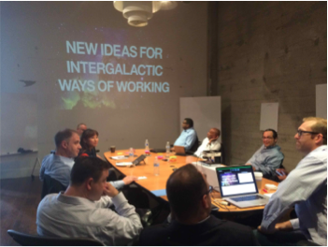
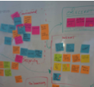
Innovation is the new currency
Blake
“Two guys in a Starbucks can have access to the same computing power as a Fortune 500 company.”
Jim Deters
Founder, Galvanize

Slide 3











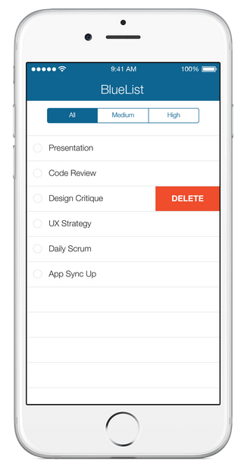
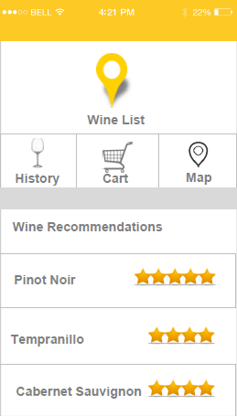
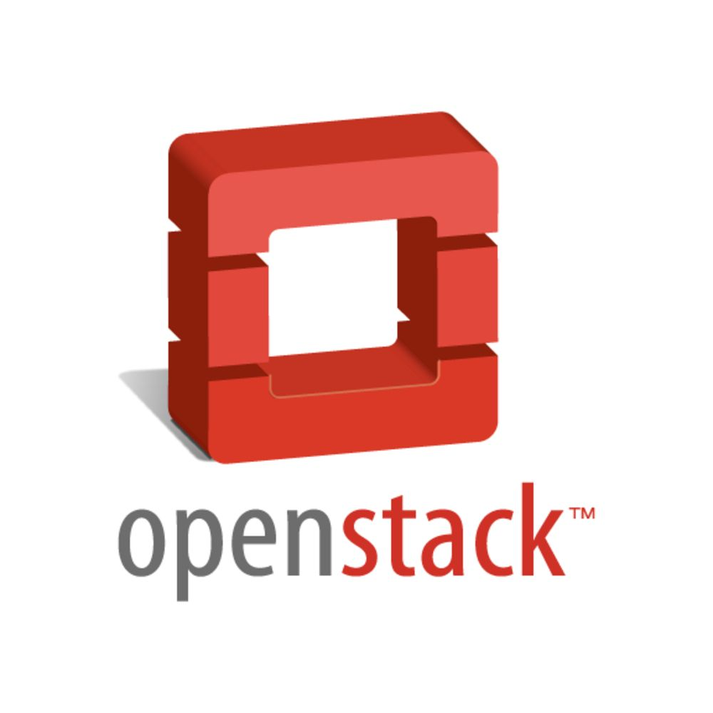



To really disrupt, a business should focus on building differentiation and rent the rest
Devs can quickly compose apps with new APIs and digital services to add features and increase engagement in areas like:
Analytics, cognition
Mobile, location
Internet of Things
Social engagement
Identity
Reviews
Travel
Messaging
…
His/her company’s private APIs and services
?

Slide 4
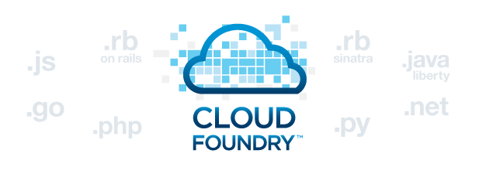

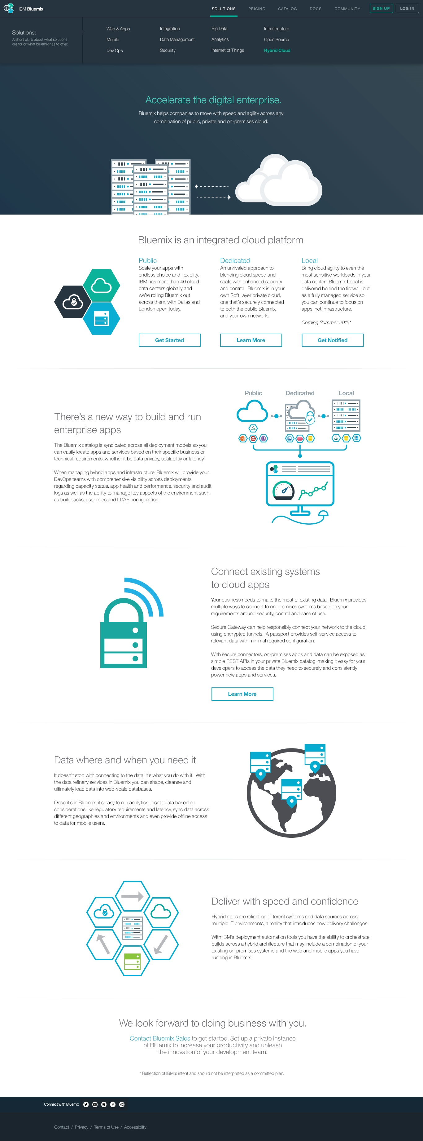
Bluemix started as a public PaaS
Bluemix started with a major focus on developer productivity in the public cloud.
Customer Managed
Service Provider Managed
Infrastructure as a Service
Platform as a Service
Code
Code
Data
Data
Runtime
Runtime
Middleware
Middleware
OS
OS
Virtualization
Virtualization
IBM SoftLayer
Servers
Servers
Storage
Storage
Networking
Networking

Slide 5


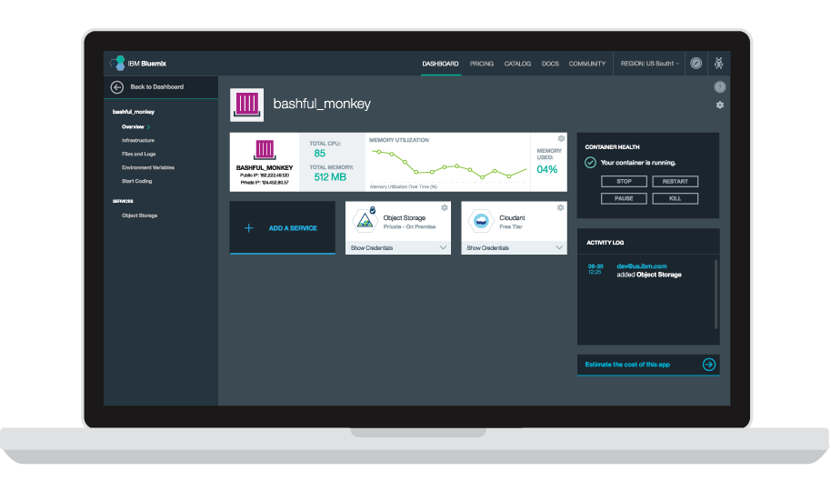



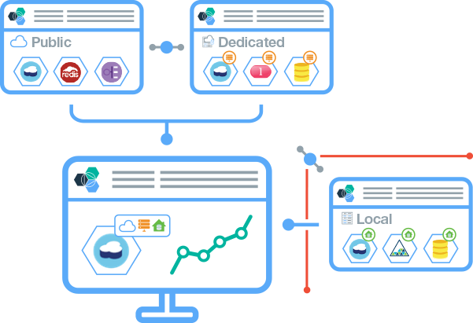
So what is Bluemix?
Bluemix is an open-standards, cloud-based platform for building, running, and managing applications.
Build your apps, your way
Use the most prominent compute technologies to power your app: Cloud Foundry, Docker, OpenStack.
Deploy and manage hybrid apps seamlessly
Get a seamless dev and management experience across a number of hybrid implementations options.
Scale more than just instances
Development, monitoring, deployment, and logging tools allow the developer to run and manage the entire application.
Layered Security
IBM secures the platform and infrastructure and provides you with the tools to secure your apps.
Flexible Pricing
Try compute options and services for free and, when you’re ready, pay only for what you use. Pay as you go and subscription models offer choice and flexibility.
Extend apps with services
A catalog of IBM, third party, and open source services allow the developer to stitch an application together quickly.
Coming Summer 2015

Slide 6
Enterprises have additional requirements
I have apps and data that must stay in a dedicated cloud or on-premises — but I want the Bluemix experience.
Security and Privacy
LDAP Integration
Regulations
Corporate Policies
White Labeling
Application monitoring and logging
“
”
“
I want to move fast but retain control.
”
I want to create new hybrid applications that use enterprise data & services.
“
”

Slide 7
We listened. Now we’re evolving to become even more flexible.
Capabilities in Bluemix now span PaaS and IaaS and can be delivered as a public, dedicated, or on-premises* implementation.
Customer Managed
Service Provider Managed
Infrastructure as a Service
Platform as a Service
Code
Code
Built on open technologies:
Data
Data
Runtime
Runtime
Middleware
Middleware
OS
OS
IBM SoftLayer
Virtualization
Virtualization
Servers
Servers
Storage
Storage
Networking
Networking
*Bluemix Local coming Summer 2015

Slide 8
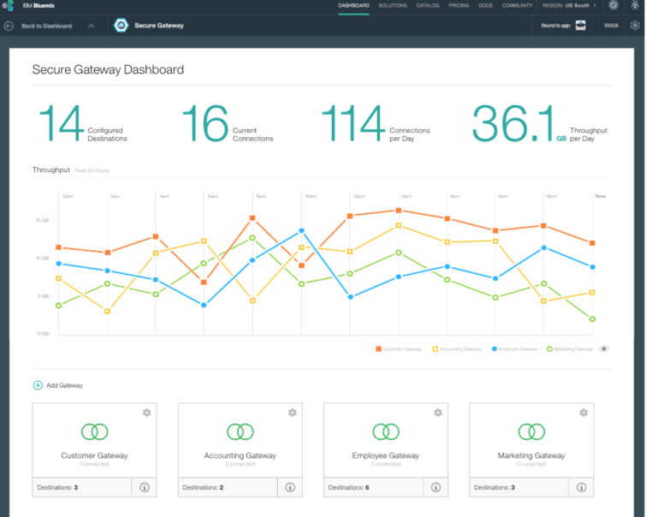
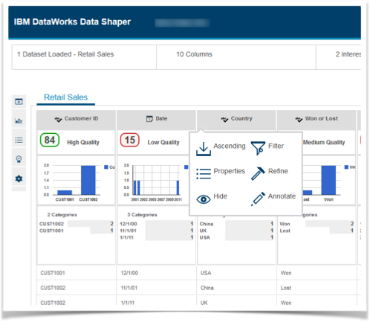
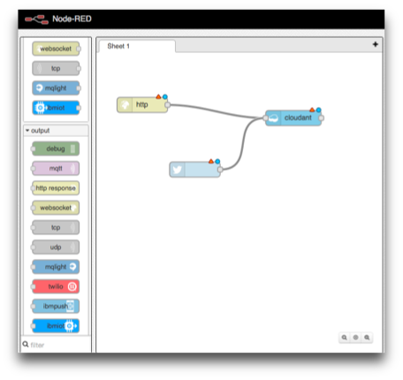
Enterprise integration, data, and API management
Five key integration, data, and API management capabilities are now built directly into Bluemix, making hybrid application architecture even easier and more flexible.
Securely access data and applications in other clouds, enterprise data centers and locally on developer laptops
Secure Gateway
Data services like: Shape data, load data, provision masked data, profile data, and classify data let you prepare your data for use in production apps
Create REST APIs from on-premises or cloud endpoints (DB2, SFDC, etc). Assemble multiple APIs into a single API using Node-RED for composition
DataWorks
Connect and Compose
Publish, promote, and oversee your APIs in a secure, scalable environment. Includes the creation of end user support resources that define and document the API
API Management
Find the right API for your app. Built from a corpus of the world’s public APIs, it understands relationships between already selected APIs and new ones being searched
API Harmony

Slide 9
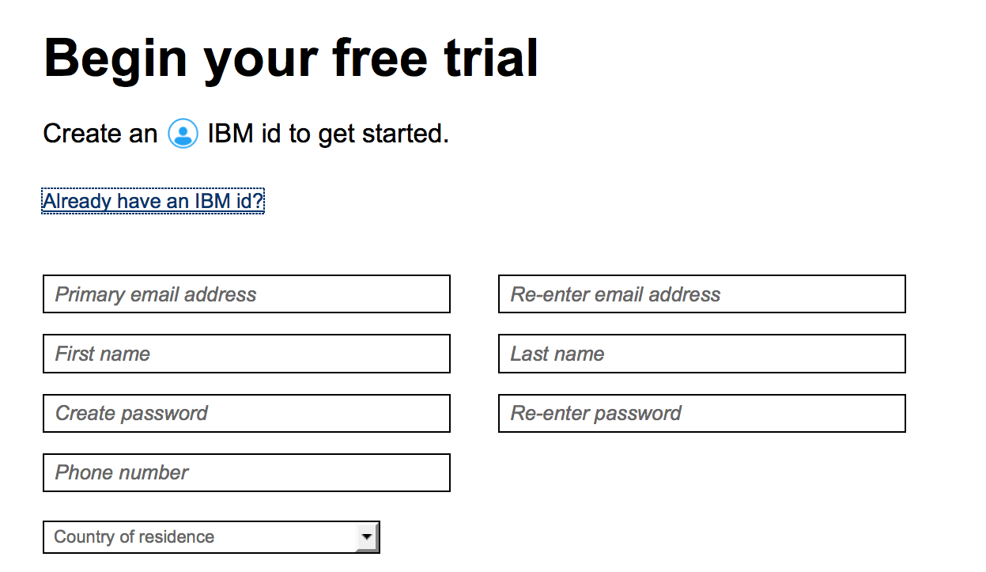
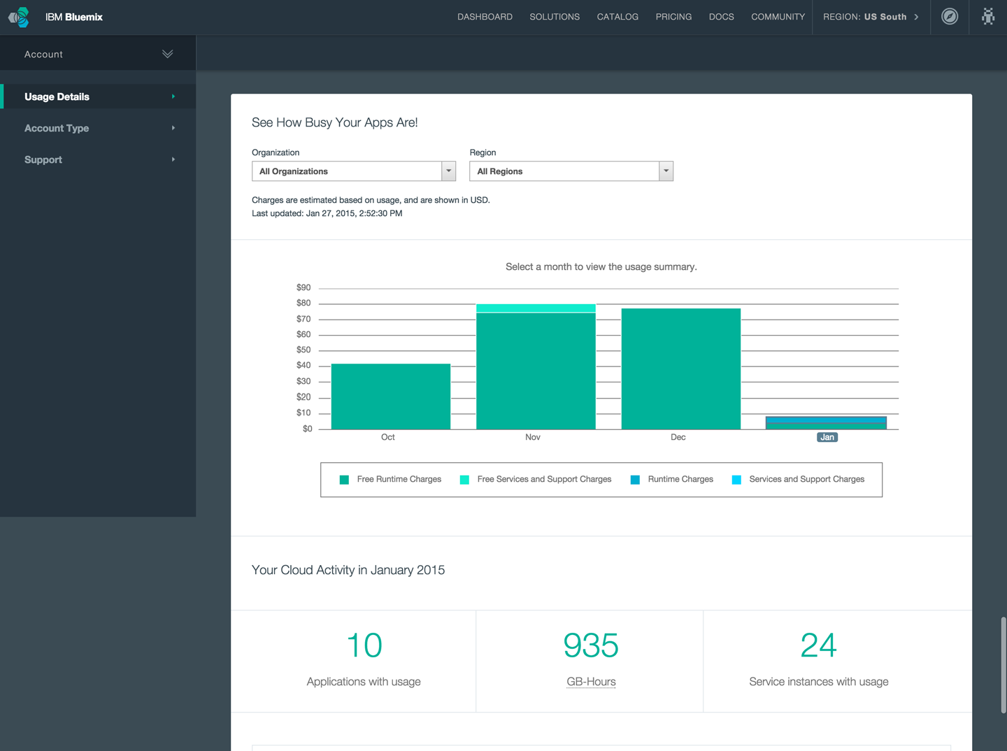
Sign up in minutes. Pay for what you use.
Cloud based pricing models to serve developer needs.
Friction free adoption
30 day trial (no credit card required) - Designed to allow testing of an entire application on the platform
Free tier for every service - encourages experimentation of new services for applications already running on Bluemix
Multiple Commitment Models
Pay-as-you-go - optimized for flexibility, no term commitment
Subscription - term based optimized for cost, discounted from pay as you go rates
Self Service
Zero to coding in less than 5 minutes
Credit card over the web in many countries - or through your IBM rep

Slide 10
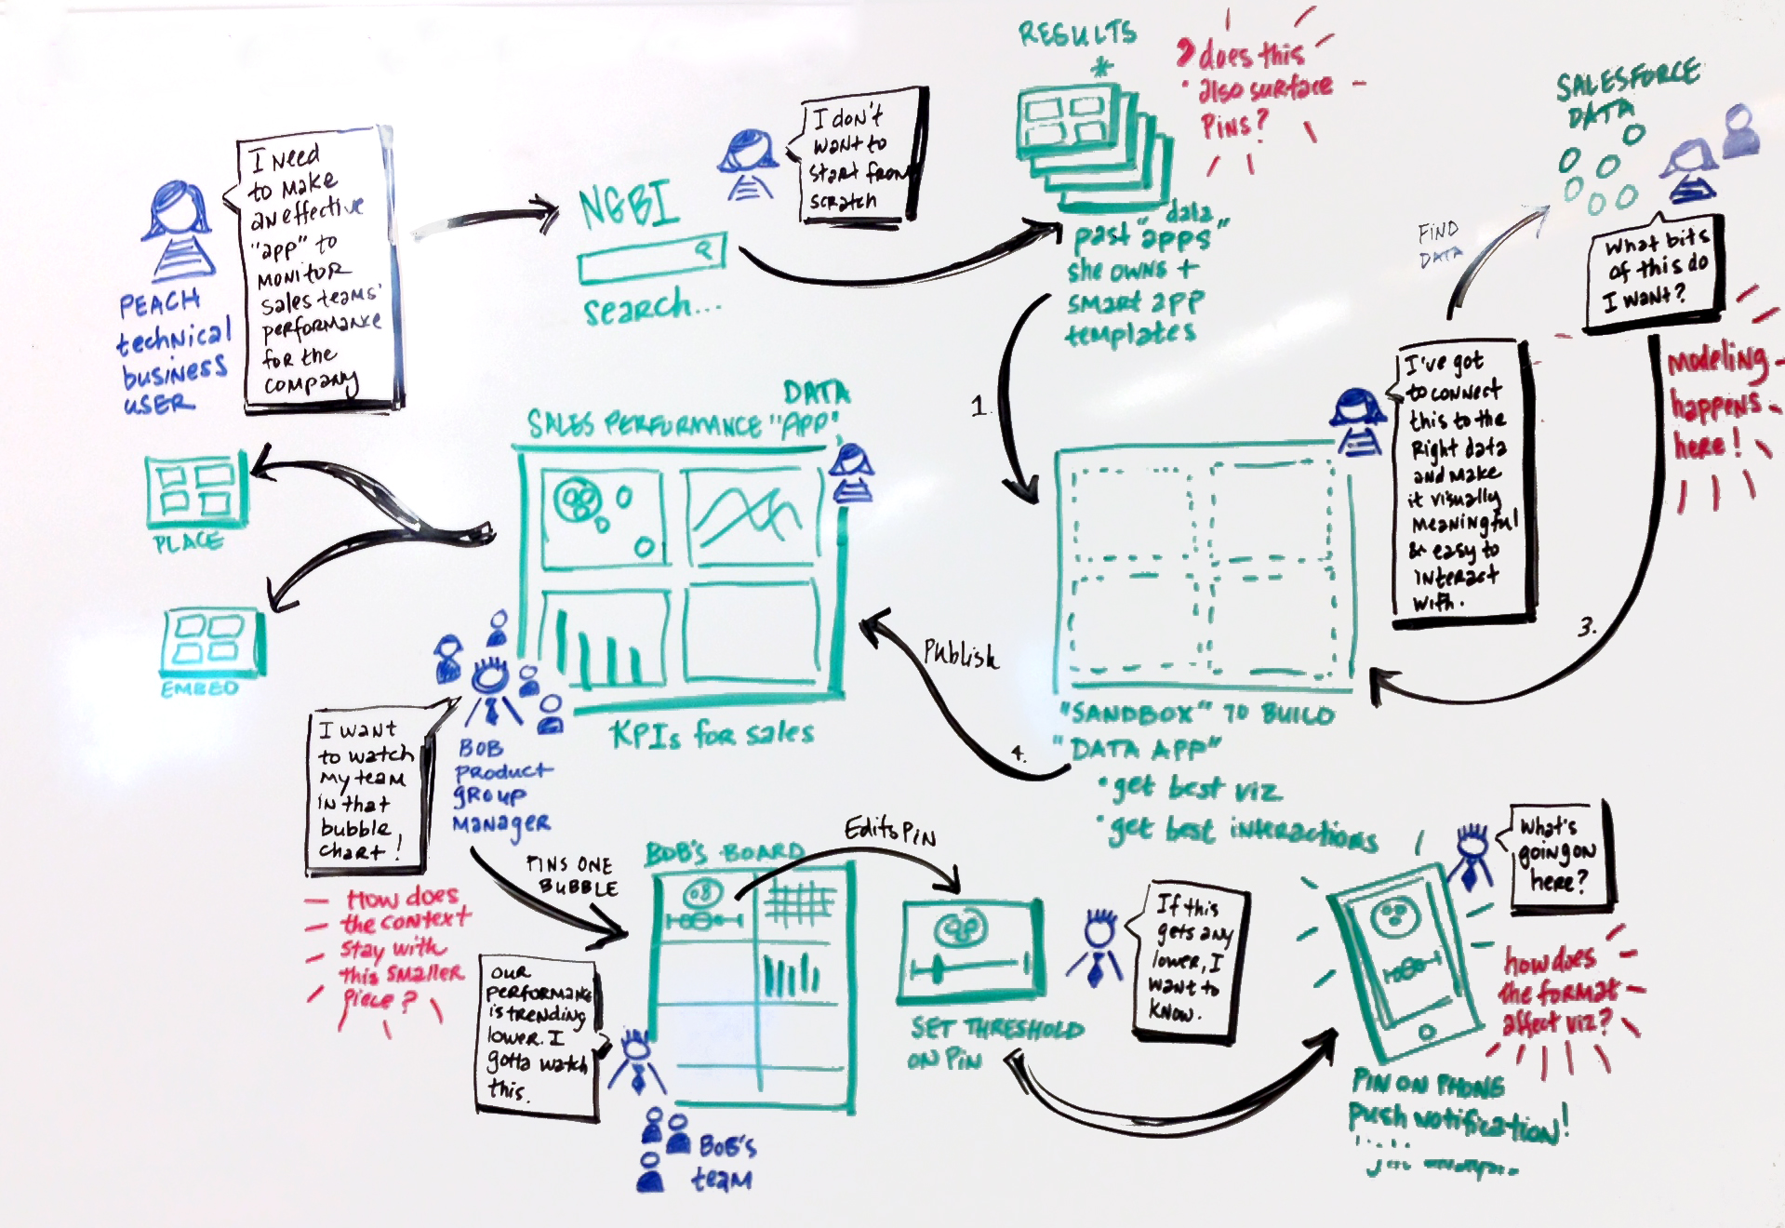

Host a Bluemix Hackathon for your devs
A Bluemix hackathon is an IBM-led two day event (at one of your locations) where your developers come together to harness the power, speed, and flexibility of Bluemix and compete to build awesome applications.
Create innovative apps
Your devs want to innovate without boundaries - let them create something incredible and have some fun.
Learn something new
We’ll bring a Bluemix expert to demo, teach, and enable during the event. Your devs will undoubtedly learn new skills.
Compete and get noticed
Devs love to compete - what’s more, they want to impress you. Let them compete to build the best hackathon app.
Realize value quickly
You’ll get to judge live, working applications that may deliver real value after two days. Imagine what 10, 30, 60 days would do.
Guide the vision
You get to choose the competition “prompt.” Meaning you guide the vision of what gets created.
The ultimate test
Who better to test out Bluemix than the people who will end up using it? Let your developers decide.

